Slide 1






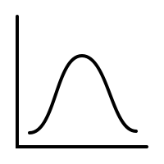


Data300 - Statistical and Machine Learning

Slide 2
Recap:
Linear Regression
Logistic Regression
Time Series
Variable Selection
Decision Trees
Support Vector Machine

Slide 3
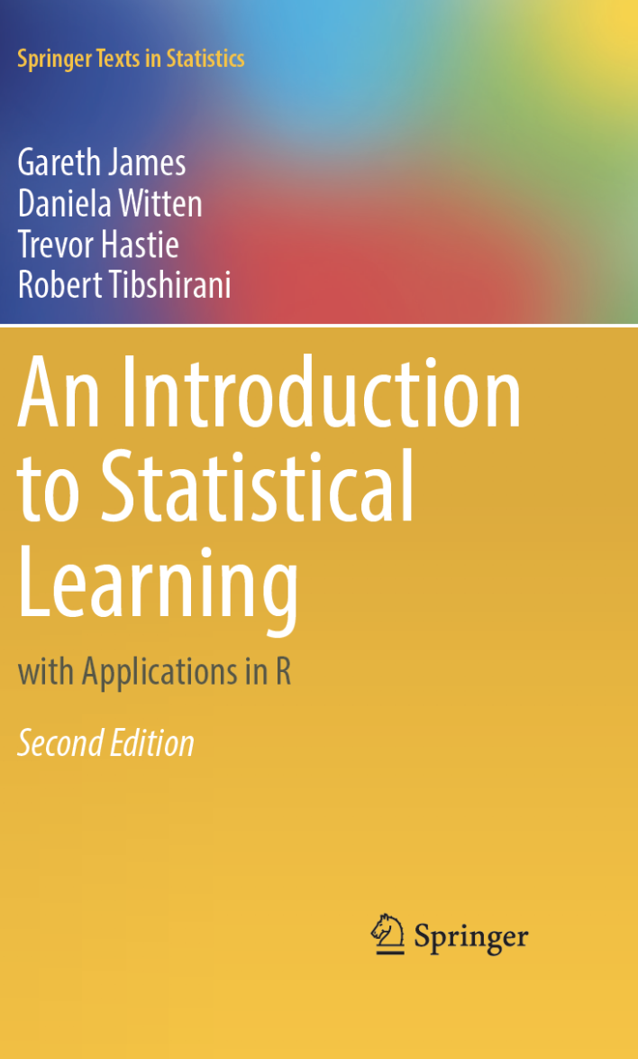
Special Thanks to:
Prof. Xiexin Liu / Lulu Wang
For the class slides and assignments Which we used to put together these slides
This book
For being free online
For diagrams and Clear explanations

Slide 4
Learning objectives:
Equip machines to learn models from data
Understand various learning algorithms and optimization
Apply algorithms to real-world problems and report outcomes
Evaluate models from data

Slide 5

Background: Assumptions
Generally speaking, a supervised learning model assumes that there is the following relationship between the predictors X and the response y:
y = f(X) + ε
Error term, unique for each y
Some function of the chosen predictors
Variability of Y not accounted for by F(X)
Response (Y)

Slide 6
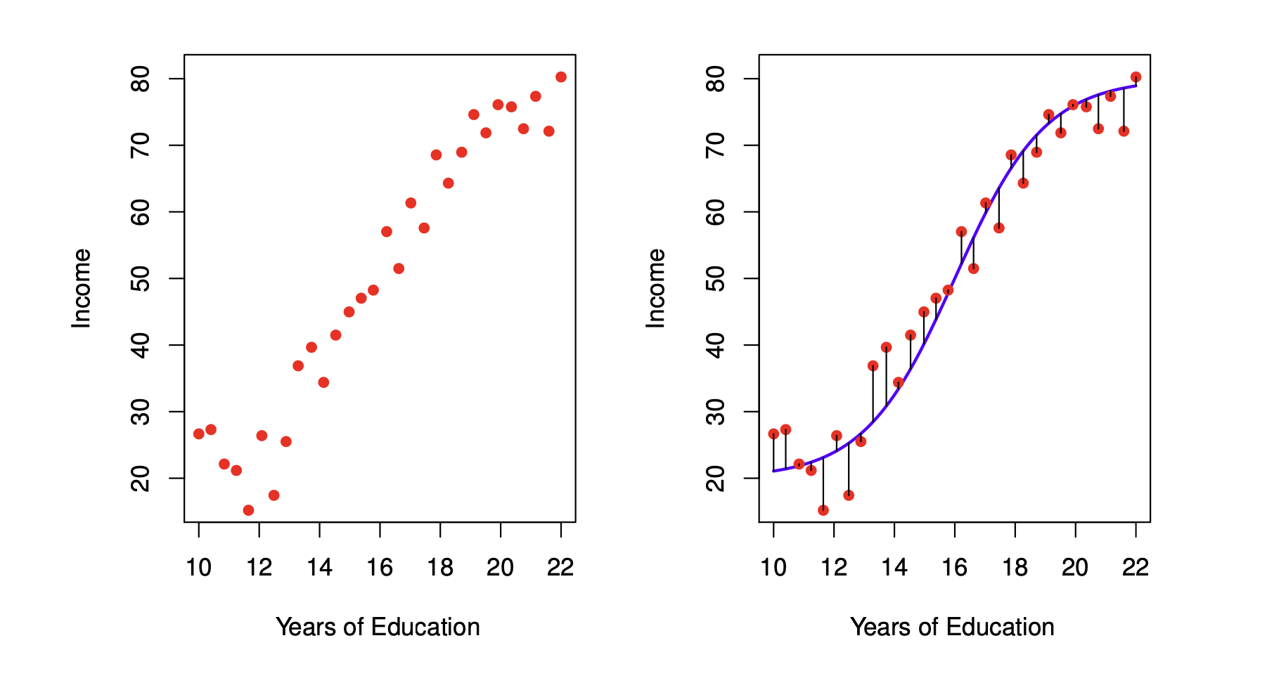
Background: Visual
f(X)
* error terms average to o
ε
ε

Slide 7

Background: The goal
Our goal is to estimate f(X) by assuming that f(X) has some form (parametric, ex: linear equation) such that
y’ = f’(X)
Resulting estimate of y
Estimate of f(X)

Slide 8
Background: Estimated v Actual
f’(X)
f(X)
f(X)

Slide 9
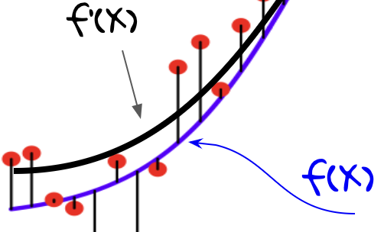
Background: actual - fitted
We want to reduce this: f(x) - f’(x),
Or: actual-fitted

Slide 10

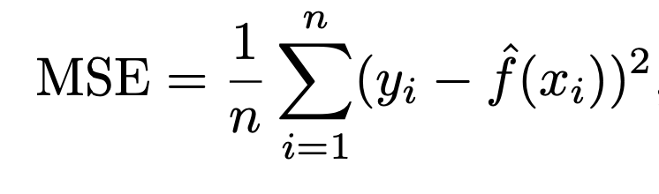
Background: MSE
In regression, the metric used to measure quality of fit is Mean Squared Error
Just means: average[ (actual - fitted)² ]

Slide 11
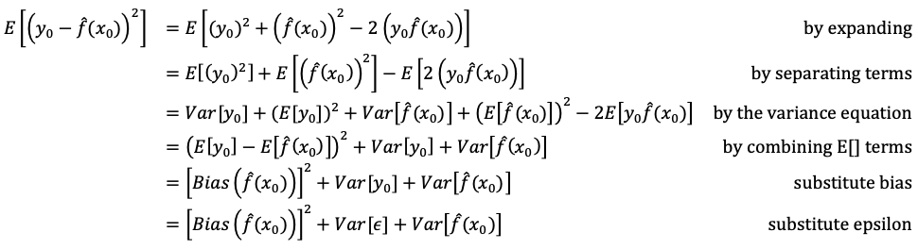

Background: MSE Expansion, Bias/Variance
MSE =
Stats

Slide 12
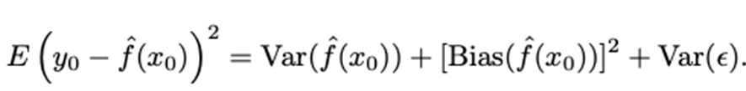
Background: MSE Expansion, Bias/Variance
Variance of a model:
The amount of change in the model when we change the training set
Bias of a model:
The error introduced by using a model to approximate a real-life problem.

Slide 13
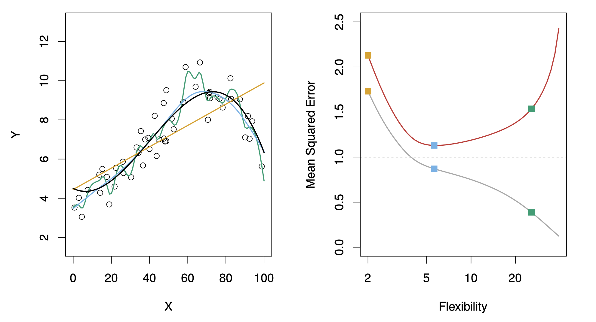

Background: Trade-off
Is the model complex enough to accurately represent the data (Bias) without overfitting the training set (Variace)
Test
Training
Black = f(X)

Slide 14
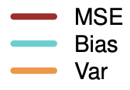
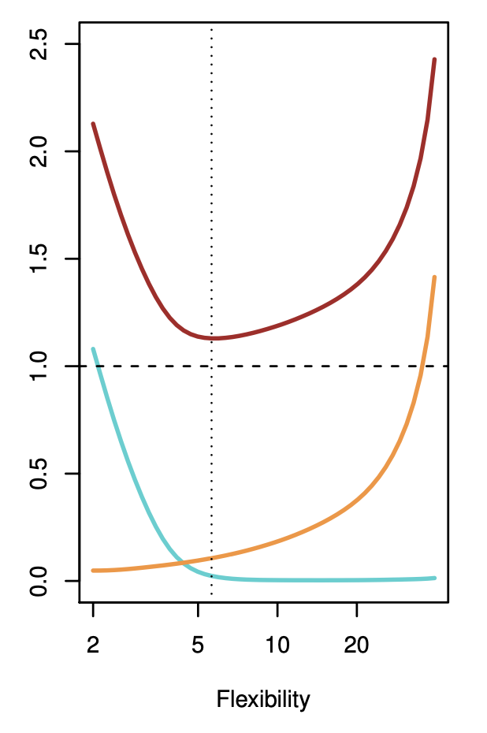
Background: Trade-off

Slide 15

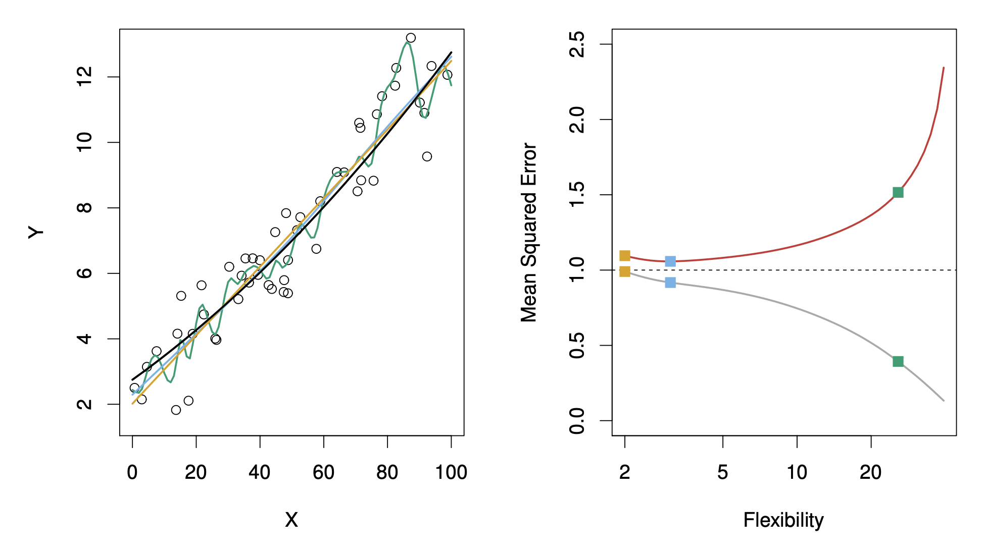
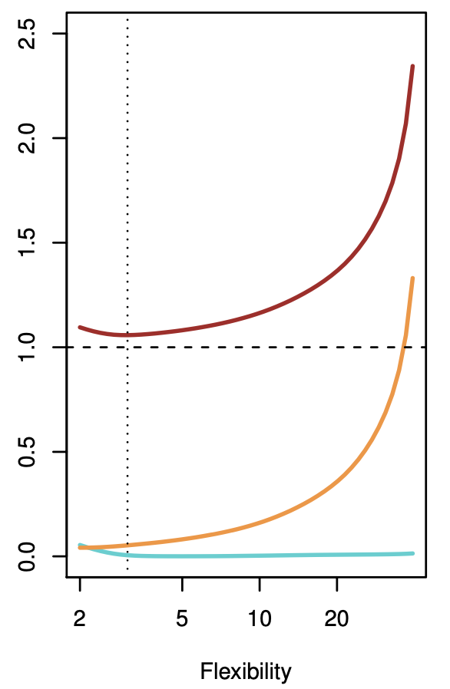
Background: Trade-off

Slide 16

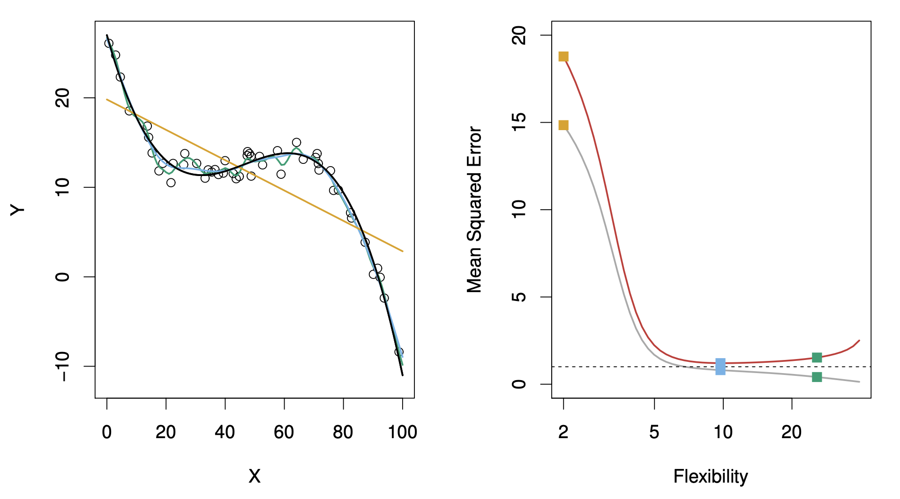
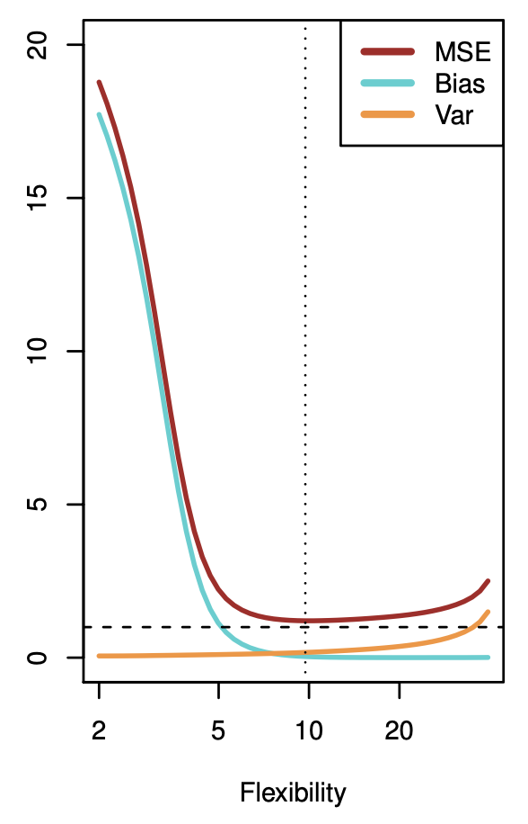
Background: Trade-off

Slide 17
Linear Regression: Big picture
LR assumes a linear relationship between the predictors and the response, or
y = f(X) + ε
y = β₀ + β₁x₁ +β₂x₂ + … + β_{d}x_{d}
We will estimate each β_{n} to get
y = b₀ + b₁x₁ +b₂x₂ + … + b_{d}x_{d}

Slide 18

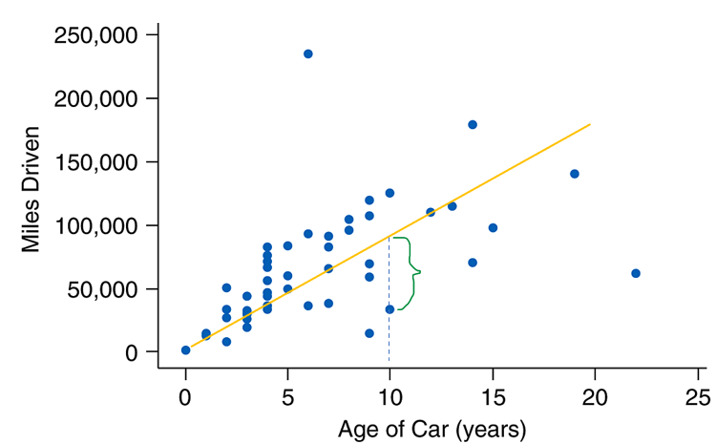
Linear Regression: OLS Brief
To estimate the β_{n} we will use Ordinary Least Squared (OLS) method
We minimize (partial derivative = 0) the sum of the the (residuals)²
y = b₀ + b₁x₁ +b₂x₂ + … + b_{d}x_{d}
residual_{i} = (observed y_{i}) – (predicted y_{i})

Slide 19
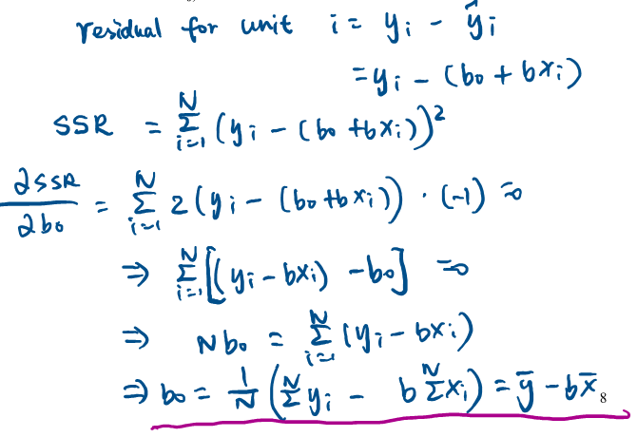
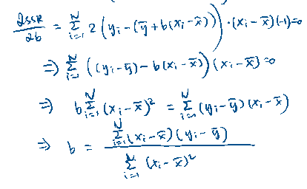


Linear Regression: OLS Brief
Example of estimates via OLS with 1 predictor:

Slide 20
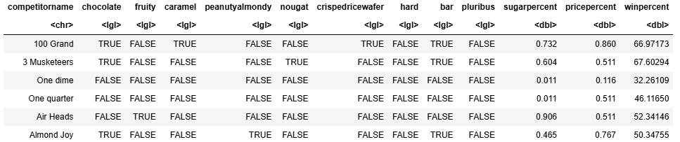
LR output
Contents are from DataCamp guided project.
Candy rankings
Winpercent: the percentage of people who prefer this candy over another randomly chosen candy from the dataset
win_mod <- lm(winpercent ~ .-competitorname, candy_rankings)

Slide 21
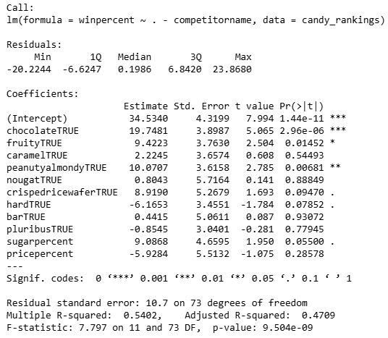
LR output
Estimate:
estimate for β_{n} (ie. the coefficients or b_{n})
Std. Error:
the average amount this estimate (b_{n}) deviates from the actual value (β_{n})
P-value:
The probability of observing this data if β_{n} = 0 (ie. if this variable has no effect on the response)

Slide 22
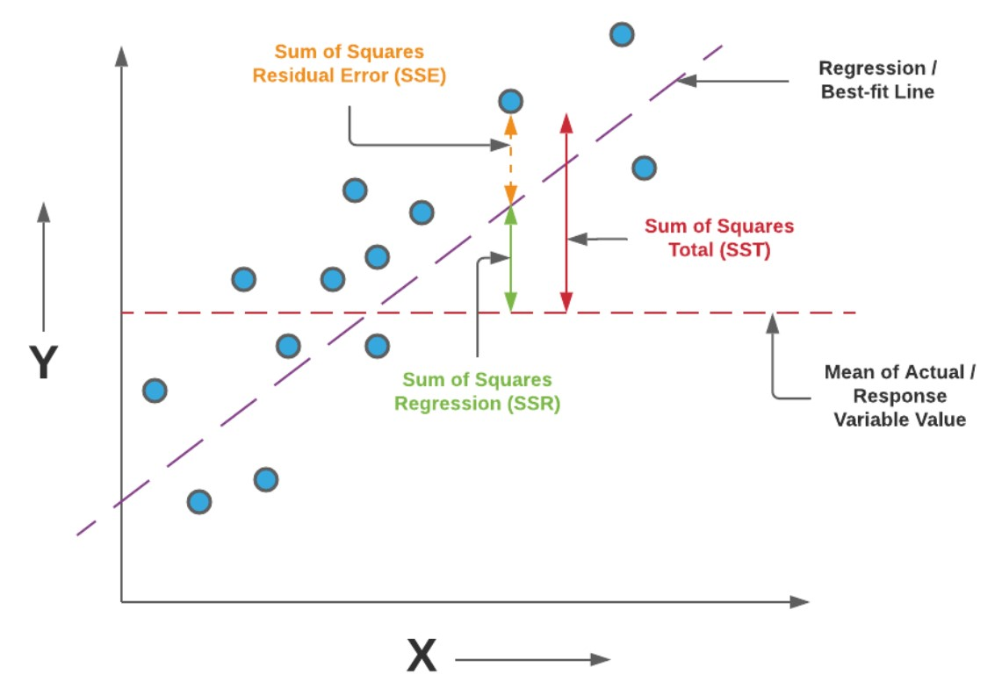
LR output
R-squared:
percentage of the variation in the response variable that is explained by the linear regression model
F-statistic p-value:
The probability of observing this data if all the β_{n} = 0
at least 1 coefficient is not 0

Slide 23
LR Interpretations
Estimate:
A 1 percent increase sugar-percent is associated with a 9.0898 increase in winpercent on average holding all other predictors fixed.
Being a chocolate candy is associated with a 19.7481 increase in winpercent on average holding all other predictors fixed.
Std. Error:
95% CI for sugar-percent: [-0.2292 , 18.4088] (contains 0)
95% CI for chocolate: [11.9507 , 27.5455] (does not contain 0)
P-value:
P-value is closely related to SE. 95% CI that don’t contain 0 guarantee that p-value < 0.05 by definition

Slide 24

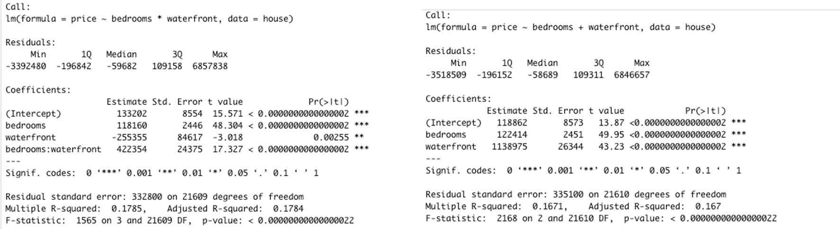
LR Possible Improvements
Model improvements:
Add an interaction term if you suspect combining two variables help explain the response.

Slide 25
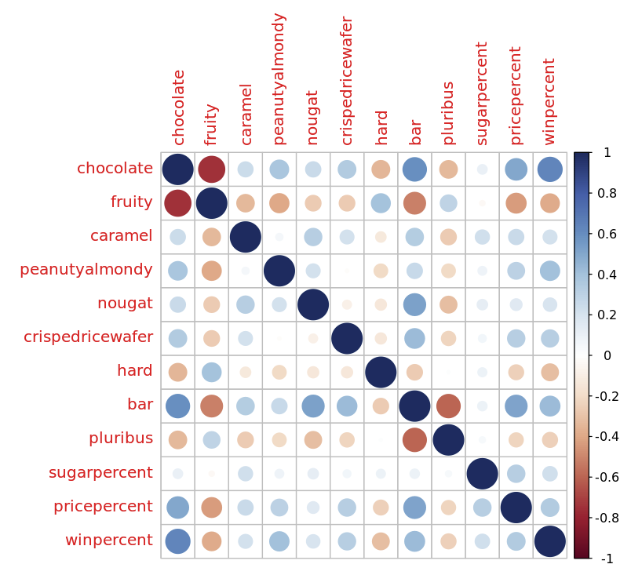

LR Possible Improvements
Model improvements:
Drop the predictors that are highly collinear

Slide 26
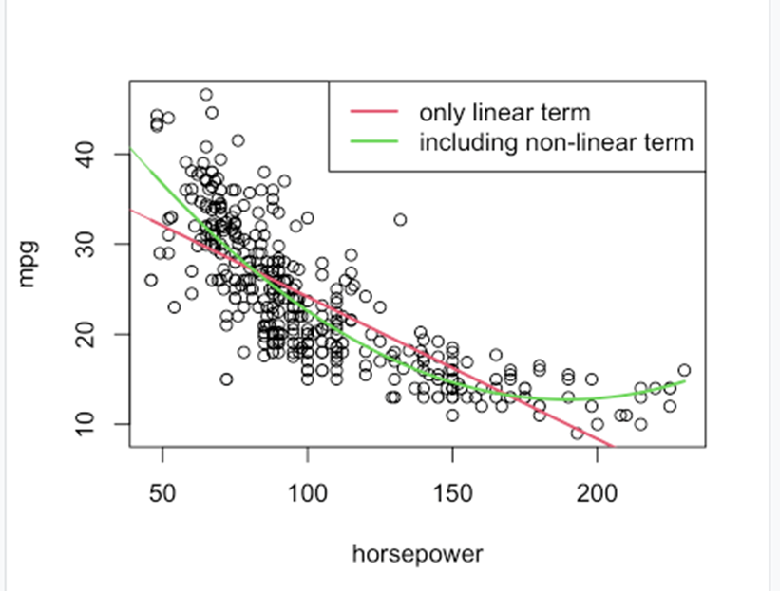
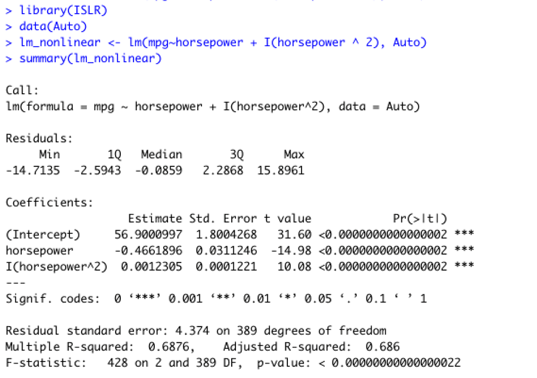
LR Possible Improvements
Model improvements:
Add non linear terms for variables with non-linear relation to response

Slide 27
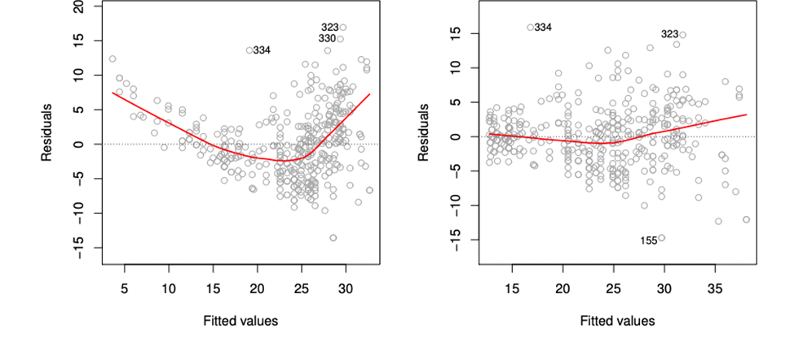
LR Possible Improvements
Model improvements:
Read the residual plots
A plot with obvious pattern would indicate non-linearity (left).
Look to add non-linear term

Slide 28
Classification: Logistic regression
Binary response variable
Predicting probability of response = 1
y = f(X) + ε
Prob(y=1) = β₀ + β₁x₁ +β₂x₂ + … + β_{d}x_{d}
Estimate
Prob(y=1) = b₀ + b₁x₁ +b₂x₂ + … + b_{d}x_{d}

Slide 29

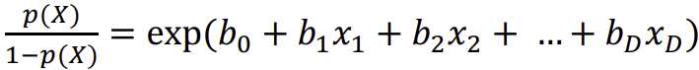
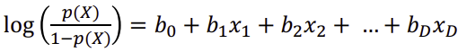
Classification: Logistic regression
Probabilities have to be [0,1], so the equation for logistic regression must be modified

Slide 30
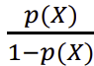

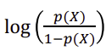
Classification: Logistic regression
: odds
Every unit change in x_{n} changes the log odds by b₁
: Log-odds (logit)

Slide 31
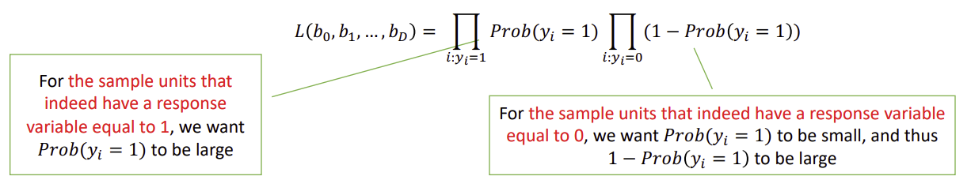

Classification: Logistic regression
To estimate the β_{n} we will use maximize Likelihood estimation
Maximize the product of: prob(y=1) and prob(y!=1) for all sample units y=1

Slide 32
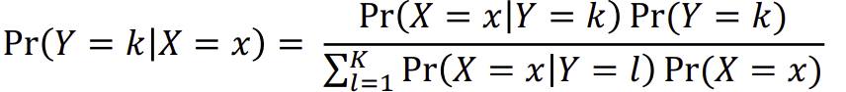
Classification: Linear Discriminant Analysis (LDA)
Another Classification Method based on Bayes Theorem
Returns probabilities that a sample unit is in each of k classes
The math is messy
Quadratic Discriminant Analysis (QDA) is an extension of LDA for quadratic classification
Better for complex patterns (Lower bias, higher variance)

Slide 33
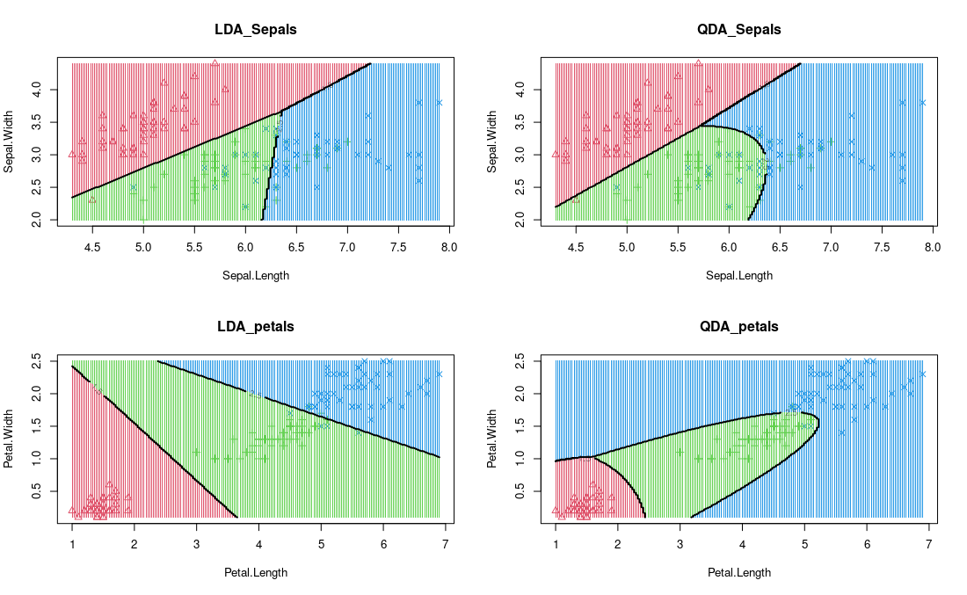

Classification: Linear Discriminant Analysis (LDA)
Before Learning LDA
After

Slide 34

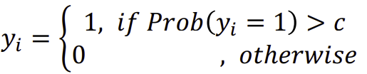
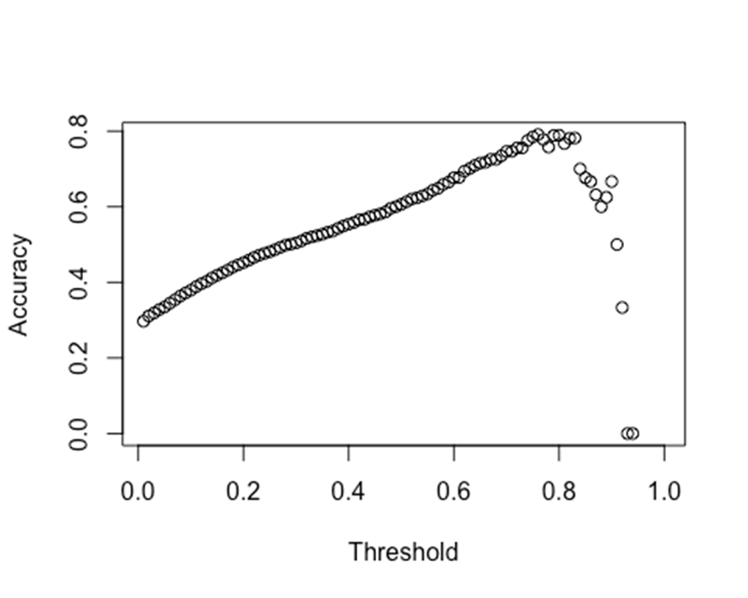
Classification: Finally, Results
Now we have probabilities
Next step is to pick a threshold, that is
TO-DO: Try different C and see which performs *best*

Slide 35

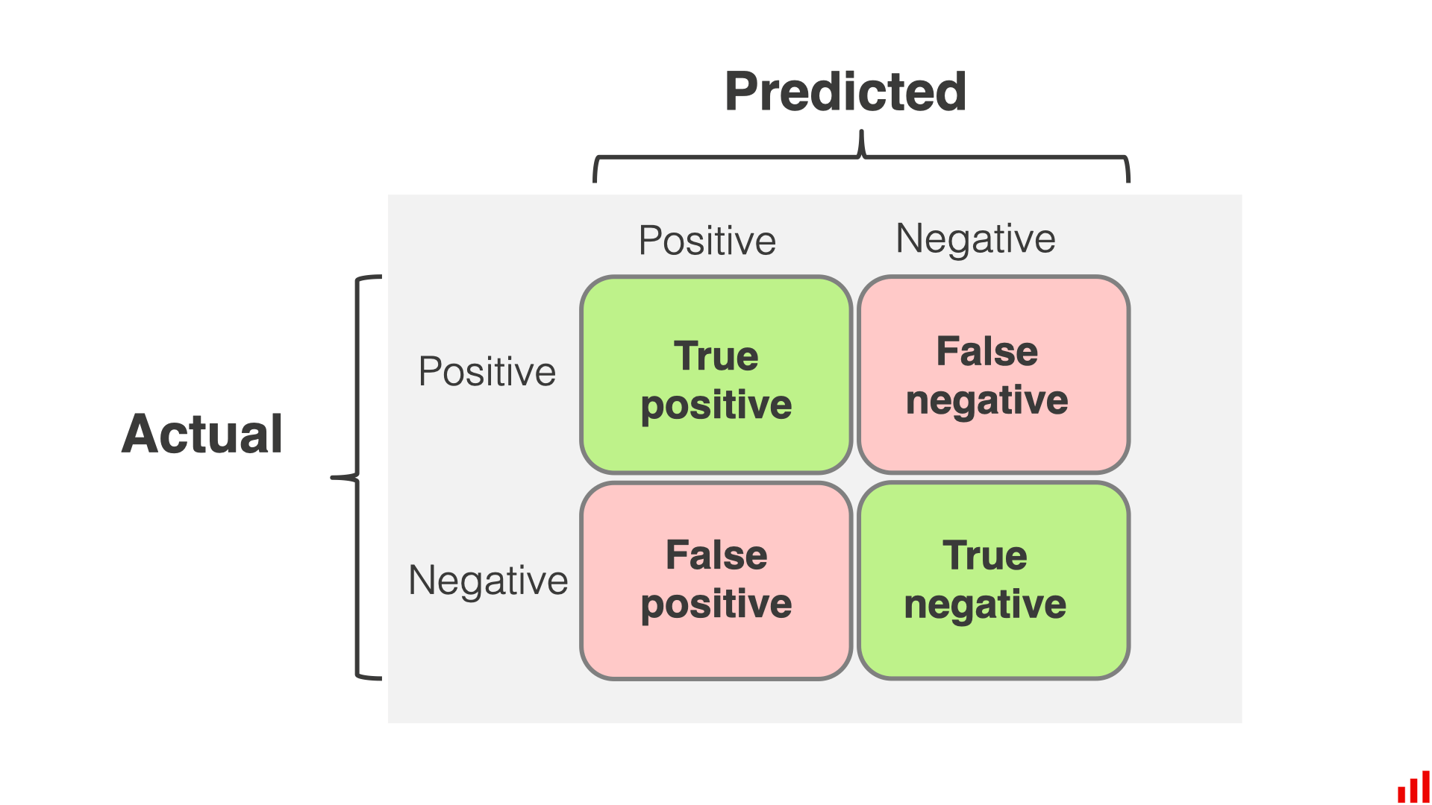
Classification: Confusion Matrix

Slide 36
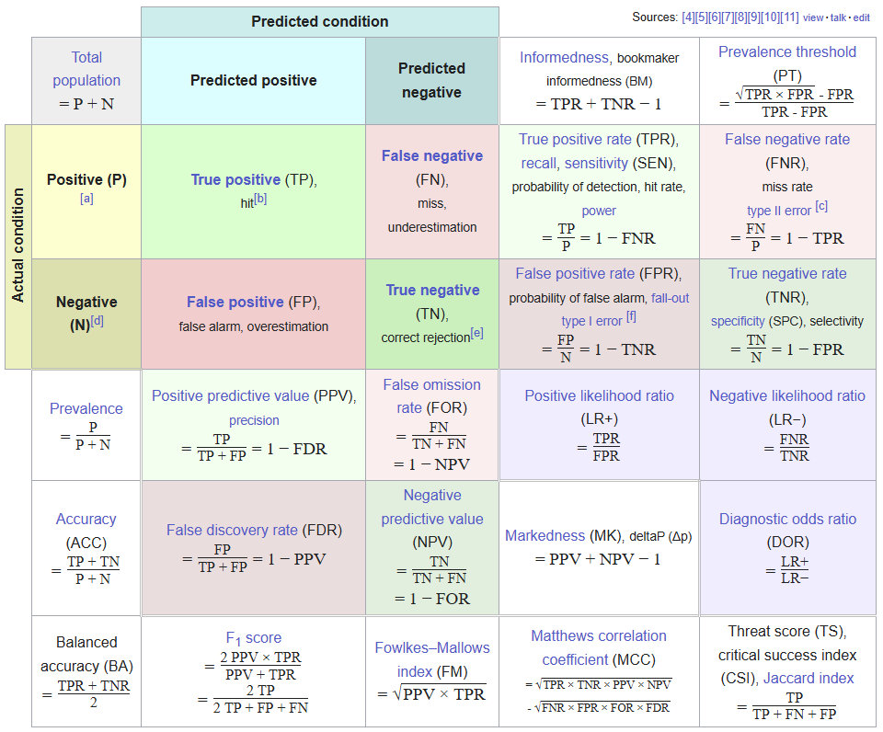
Classification: Metrics

Slide 37

Classification: Sampling
Unbalanced data set:
Over or under or Hybrid sampling
For any data set:
Bootstrapping
Sample with replacement to create multiple data sets
K-fold validation
Split data into k validation sets and average performance

Slide 38
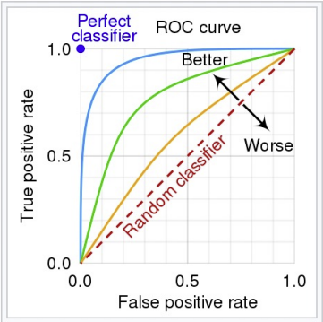
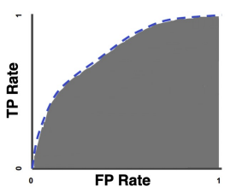
Classification: ROC Curve & AUC
A ROC (Receiver Operating Characteristics) curve is to measure the overall performance of a classification model under different thresholds.
A.U.C.

Slide 39
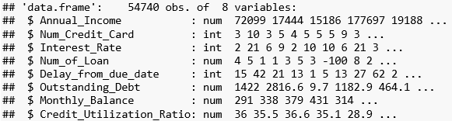
Classification: Logistic Results
Demo results are from a homework assignment looking at predicting good/bad credit (credit mix)

Slide 40
Classification: Logistic Results
## Call:
## glm(formula = Credit_Mix ~ Annual_Income + Num_Credit_Card + Interest_Rate +
## Num_of_Loan + Delay_from_due_date + Outstanding_Debt + Monthly_Balance +
## Credit_Utilization_Ratio, family = binomial, data = trainingSet)
##
## Coefficients:
## Estimate Std. Error z value Pr(>|z|)
## (Intercept) 6.937e-01 9.592e-02 7.232 4.77e-13 ***
## Annual_Income 4.627e-09 9.892e-09 0.468 0.6399
## Num_Credit_Card 8.013e-05 1.064e-04 0.753 0.4512
## Interest_Rate 1.736e-05 2.844e-05 0.610 0.5416
## Num_of_Loan -4.357e-04 2.412e-04 -1.806 0.0709 .
## Delay_from_due_date -1.159e-01 1.923e-03 -60.262 < 2e-16 ***
## Outstanding_Debt -8.034e-04 2.476e-05 -32.441 < 2e-16 ***
## Monthly_Balance 1.382e-03 6.282e-05 21.993 < 2e-16 ***
## Credit_Utilization_Ratio 4.073e-03 2.850e-03 1.429 0.1529
## ---## Signif. codes: 0 '***' 0.001 '**' 0.01 '*' 0.05 '.' 0.1 ' ' 1

Slide 41
Classification: Logistic Results
## Delay_from_due_date -1.159e-01 1.923e-03 -60.262 < 2e-16 ***
Delay_from_due_date: Each day that payment is delayed lowers log-odds of having good credit mix by .116 on average holding all other predictors fixed.
Log odds to odds:
e^-.116 = odds ratio = 0.8907
% change in odds = (1-odds ratio) = 0.1093
In terms of odds: The odds of having good credit mix decreases 11% on average, holding all other predictors fixed, for each day that payment is delayed.

Slide 42
Classification: LDA Results
## lda(Credit_Mix ~ Annual_Income + Interest_Rate + Outstanding_Debt + ## Monthly_Balance + Credit_Utilization_Ratio, data = trainingSet) ## ## Prior probabilities of groups: ## 0 1 ## 0.7562879 0.2437121 ## ## Group means: ## Annual_Income Interest_Rate Outstanding_Debt Monthly_Balance Credit_Utilization_Ratio ## 0 172446.0 75.80516 1643.0174 370.8372 32.07871 ## 1 189063.3 76.45034 733.7616 503.5104 32.95380 ## Coefficients of linear discriminants: ## LD1 ## Annual_Income 6.169737e-09 ## Interest_Rate 2.730176e-05 ## Outstanding_Debt -7.042019e-04 ## Monthly_Balance 2.321958e-03 ## Credit_Utilization_Ratio 5.974218e-03

Slide 43
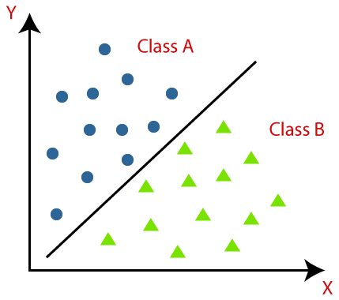
Classification: LDA Results
These coefficients represent the linear combination of the predictor variables that best separate the two classes.
## Annual_Income 6.169737e-09 ## Interest_Rate 2.730176e-05 ## Outstanding_Debt -7.042019e-04 ## Monthly_Balance 2.321958e-03 ## Credit_Utilization_Ratio 5.974218e-03

Slide 44

Time Series

Slide 45

Time Series
Sequence of data points recorded over time
Time series data has an implicit order, meaning the sequence of data points matters
N sample units with only ONE variable, but this variable is recorded on T different time stamps

Slide 46

Time Series
Involves machine learning algorithms to analyze and predict future values based on historical data collected over time, like stock prices or weather patterns

Slide 47
Time Series Data: Components
Trend: This represents the overall direction in which the data is moving over a long period. For example, the gradual increase in average global temperatures is a trend.
Seasonality: These are patterns that repeat at regular intervals. For example, increased ice cream sales during summer months.
Cyclic changes: These are fluctuations that occur irregularly but are not of fixed period, unlike seasonality. These could be tied to economic conditions like recessions.
Random noise: These are random fluctuations in the data that do not follow any pattern and are unpredictable.

Slide 48

Time Series Analysis: Challenges
Stationarity: Time series analysis often requires the data to be stationary. This means the statistical properties of the series like mean and variance should not be a function of time.
High dimensionality: Some time series are multivariate and contain multiple variables at each time step, which increases the complexity of the model.
Missing values and anomalies: Time series data can have gaps or outliers that need to be handled before analysis.

Slide 49
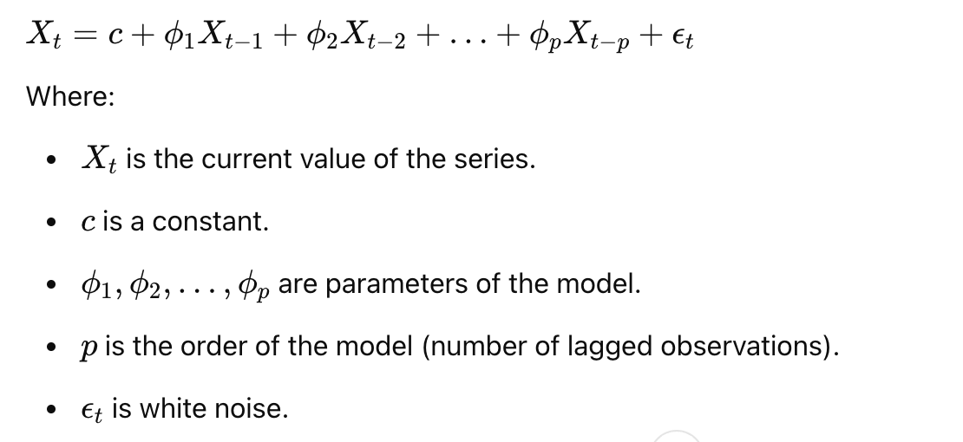
Time Series Analysis: Models
1. Autoregressive (AR) Models
predicts future behavior based on past behavior
assumes that the current value of the series is a linear combination of previous values plus an error term. The model can be expressed as:

Slide 50
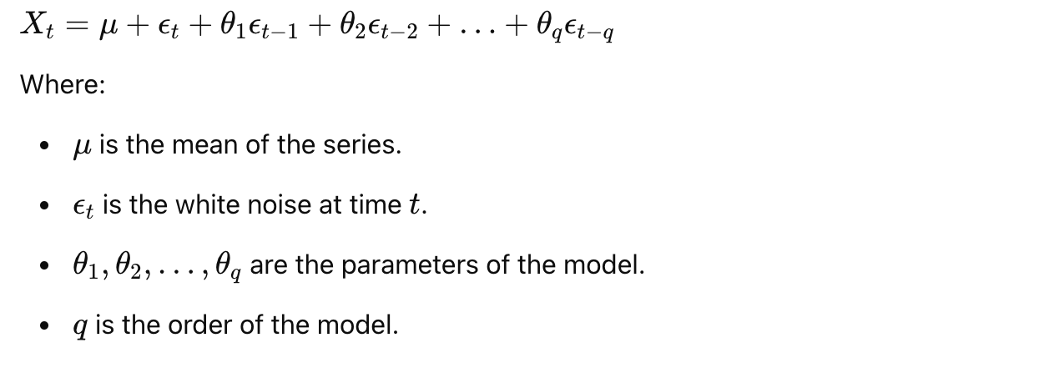
Time Series Analysis: Models
2. Moving Average (MA) Models
model uses past forecast errors in a regression-like model.
Unlike AR models, which are based on the values of the series, MA models are based on the errors of past predictions. It can be expressed as:

Slide 51
Time Series Analysis: Models
3. Autoregressive Moving Average (ARMA) Models
combine both AR and MA models. They are used when a series is stationary, meaning it has constant mean and variance. The ARMA model is given by:
This model is specified by two parameters, p (order of the AR part) and q (order of the MA part)

Slide 52
Time Series Analysis: Models
4. Autoregressive Integrated Moving Average (ARIMA) Models
used to make a non-stationary series stationary before using ARMA models.
done by differencing the series, i.e., computing the differences between consecutive observations.
The ARIMA model is generally denoted as ARIMA(p, d, q), where:
p is the number of autoregressive terms.
d is the number of differences needed for stationarity.
q is the number of moving average terms.

Slide 53
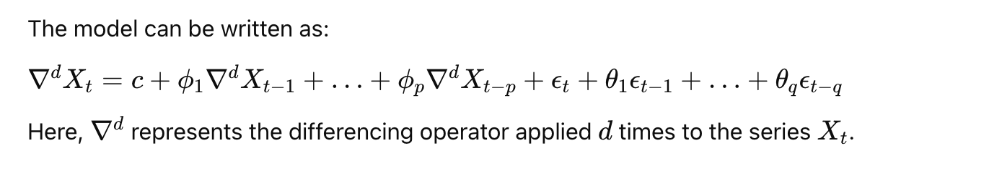

Time Series Analysis: Models

Slide 54

Variable Selection
Bias tends to be low as we have more predictors.
Variance tends to be low as we have less predictors.
In other words, when bias is already small enough, having less
predictors might be able to reduce variance A LOT without hurting
bias too much.

Slide 55

Variable Selection: Best Subset
Try every combination of models with k variables from k = 1 to all variables
Not optimized.

Slide 56

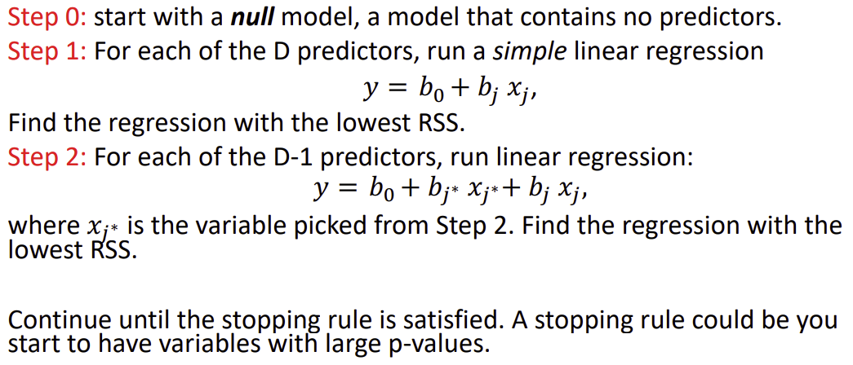
Variable Selection: Step-wise
Forward:

Slide 57

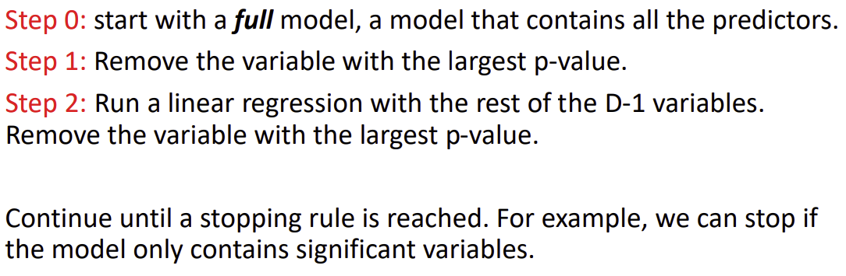
Variable Selection: Step-wise
Backwards:

Slide 58

Variable Selection: Metrics
All the selection methods (best subset, forward, backward) require a user-defined stopping rule. The easiest one to implement in
R is to minimize the Akaike information criterion (AIC).
In short, AIC is an estimator of the prediction error.
Why do we not want to use MSE or R²?
*Bias / Variance*

Slide 59

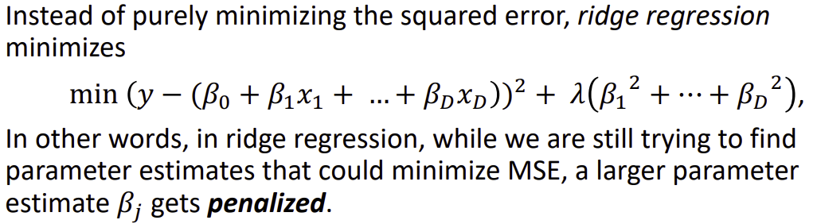
Variable Selection: Shrinkage methods
Loss + Penalty
λ is called a tuning parameter/hyperparameter. A larger λ signals a heavier penalty on large parameter estimations.

Slide 60
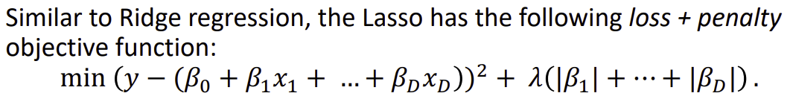
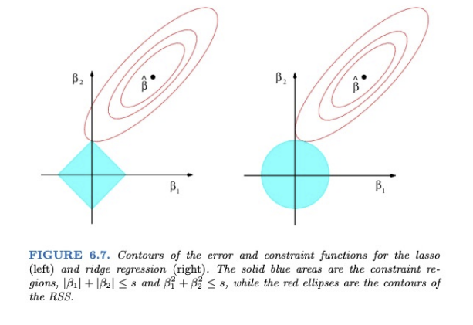
Variable Selection: Shrinkage methods
Optimal
w/o penalty
Note that ridge (right) does not touch the y-axis when it makes contact with the constraint
Penalty

Slide 61
Variable Selection: Shrinkage methods
Practical difference:
The parameter estimates could be really small in
Ridge, but they will NEVER be 0
Thus, can’t be eliminated from the model

Slide 62
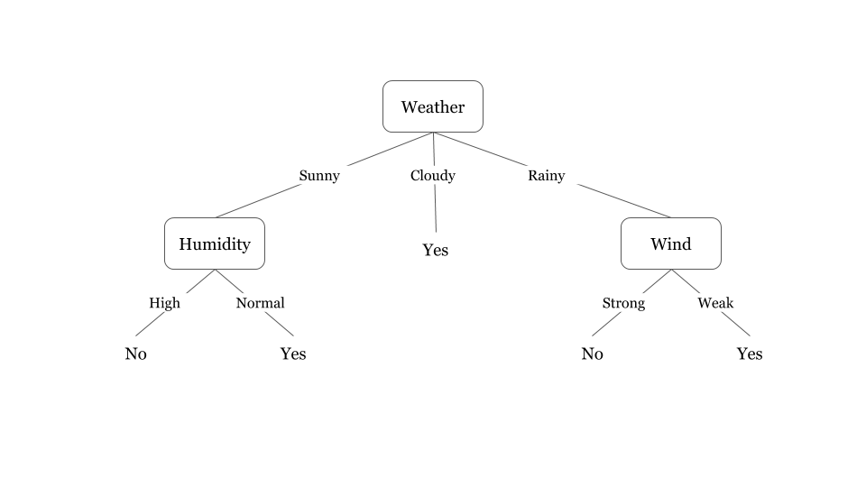
Decision Trees
- Definition: A decision tree is
a flowchart-like structure used
for classification and regression
tasks.
- Importance: Simple to understand, interpret, and visualize.
- Application: Used in finance, healthcare, marketing, and more.
Notes:
Boosting and random forest

Slide 63
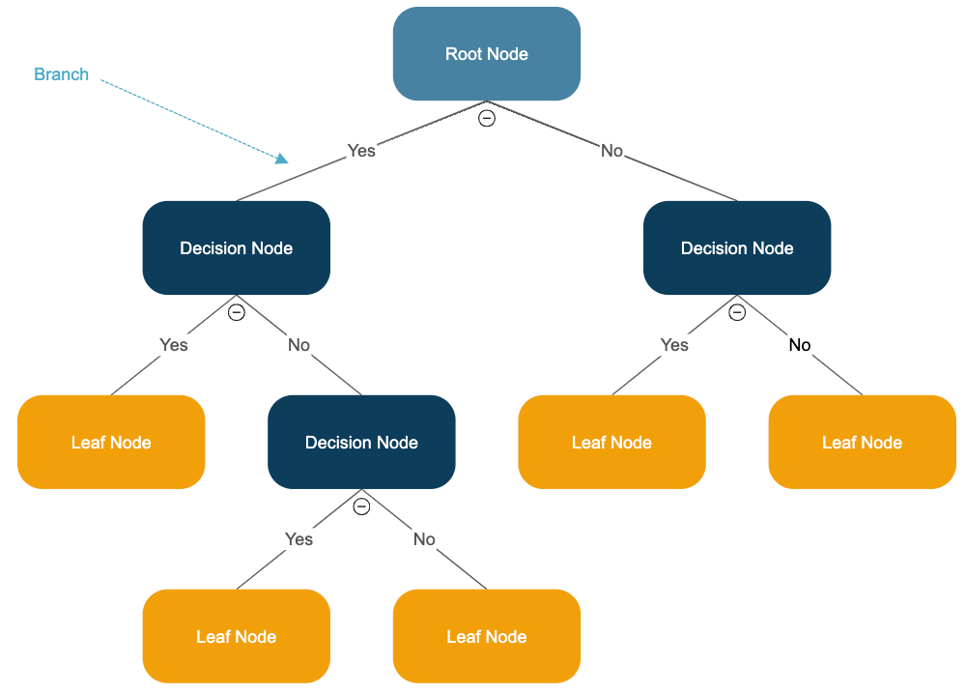
Components of a Decision Tree
- Root Node: Represents the
entire dataset and splits into
child nodes.
- Decision Nodes: Points where the dataset is split based on
a feature.
- Leaf Nodes: Final output labels or
values.

Slide 64

Classification vs. Regression Trees
- Classification Trees: Used
when the target variable is
categorical (e.g., spam vs. not
spam).
- Regression Trees: Used when the
target variable is continuous
(e.g., predicting house prices).

Slide 65

Strengths and Weaknesses of Decision Trees
Advantages:
- Easy to interpret and visualize
- Requires minimal data preprocessing
- Handles both numerical and categorical data
Disadvantages:
- Prone to overfitting
- Can be unstable with small data changes
- Not as accurate as ensemble methods

Slide 66

Understanding Random Forest Classifier
- Definition: A Random Forest is an
ensemble learning method using
multiple decision trees.
- Importance: Reduces overfitting,
improves accuracy compared to single
decision trees.
- Application: Used in finance,
healthcare, and image recognition.

Slide 67

How do random forest work
- Constructs multiple decision trees
from randomly sampled data.
- Aggregates predictions (majority vote
for classification, average for regression).
- Reduces variance and improves generalization.

Slide 68
Using boosting to improve Decision Tree based models
Definition: Boosting is an ensemble learning technique that combines multiple weak models to create a strong predictive model.
How it Works: Models are trained sequentially, with each new model focusing on correcting the errors of the previous ones.
Main Algorithms:
AdaBoost: Adjusts weights to focus on misclassified samples.
Gradient Boosting (GBM): Uses gradient descent to minimize errors.
XGBoost: Optimized GBM with speed and performance improvements.
LightGBM: Faster training, handles large datasets efficiently.
CatBoost: Specialized for categorical data.

Slide 69

Using boosting to improve Decision Tree based models
Advantages:
Reduces bias and variance for high accuracy.
Works well with structured data.
Handles both classification and regression tasks.
Challenges:
Computationally intensive.
Requires careful hyperparameter tuning to avoid
overfitting.

Slide 70
Strengths and Weaknesses of Decision Trees
Advantages:
- Easy to interpret and visualize
- Requires minimal data preprocessing
- Handles both numerical and categorical data
Disadvantages:
- Prone to overfitting
- Can be unstable with small data changes
- Not as accurate as ensemble methods

Slide 71

Support Vector Machines (SVM)
- Definition: SVM is a
supervised learning algorithm
used for classification and
regression tasks.
- Importance: Effective in
high-dimensional spaces, robust
to overfitting.
- Application: Used in image recognition, bioinformatics, and text classification.

Slide 72

Support Vector Machines (SVM)
- Identifies the optimal hyperplane
that best separates different
classes.
- Maximizes the margin between
data points and the decision
boundary.
- Uses support vectors to define
the margin.

Slide 73

Linear vs. Non Linear SVM
- Linear SVM: Works well when
data is linearly separable.
- Non-Linear SVM: Uses kernel
functions to map data into
higher dimensions for better
separation.

Slide 74

Kernel Functions in SVM
- Linear Kernel: Suitable for
linearly separable data.
- Polynomial Kernel: Captures
complex relationships.
- Radial Basis Function (RBF)
Kernel: Effective for non-linearly separable data.
- Sigmoid Kernel: Mimics neural
networks.

Slide 75
Pros and Cons of SVM
Advantages:
- Effective in high-dimensional spaces.
- Works well with small datasets.
- Robust to overfitting (especially with regularization).
Disadvantages:
- Computationally expensive for large datasets.
- Choice of kernel impacts performance.
- Difficult to interpret compared to decision trees.

